Slide 1
“LBp- Texture Method”
Object detection
- PULKIT PRAKASH

Slide 2

Content:
Steps Involved in object detection and tracking
LBP (linear binary pattern)
How To use LBP for object detection ?
- Comparison B/w Histograms
- Selection Of Most Probable Background Models
- Foreground detection
Experiment result

Slide 3
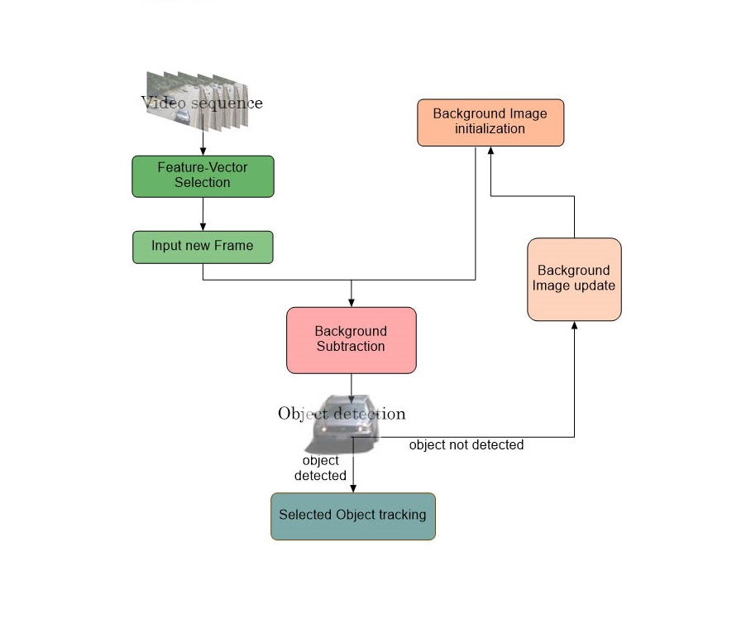
Steps Involved in object detection and tracking

Slide 4
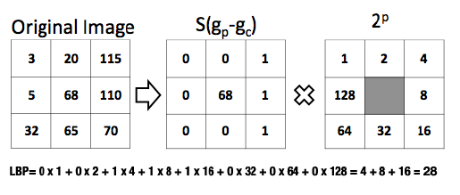
LBP (linear binary pattern)
Fig 1: Calculating the LBP code

Slide 5

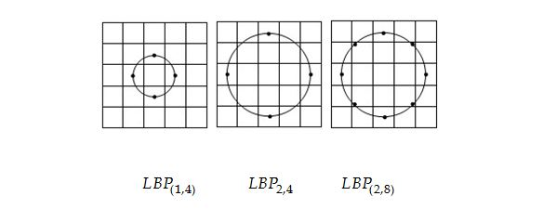

LBP Operator:
$LBP(x_{c},y_{c})$ = $\sum_{p=0}^{p−1}{s(g_{p}−g_{c})}2^{p}$
where, $g_{c}$ = grey value of the center pixel $(x_{c},y_{c})$
$g_{p}$ = grey values of the p neighborhood pixels
S(x) is defined as: s(x) = $\left\{\begin{aligned}1 x≥0 \\ 0 x<0\end{aligned}\right.$
Fig 2: Circular symmetric neighbor sets for diff values of P and R

Slide 6
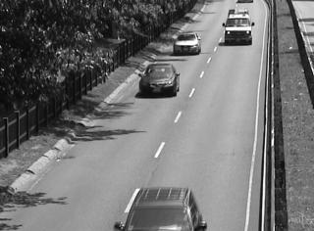
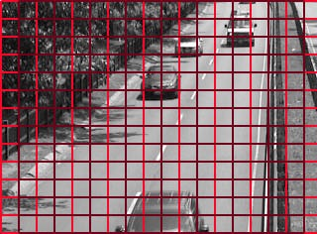
How To use LBP for object detection ?
Divide each new video frame into equally sized blocks by using partially overlapping grid structure
Original image
Image with partially overlapping grid structure
(shown with two different color of boxes)

Slide 7

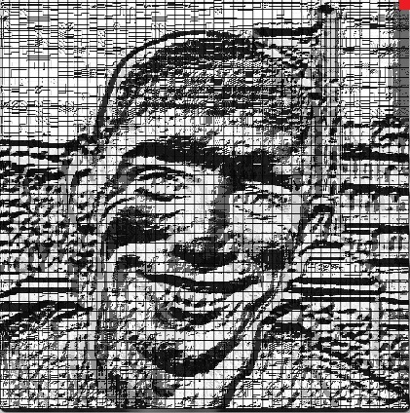
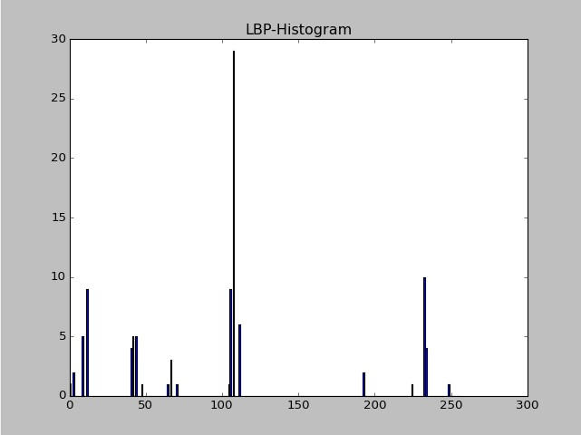
Consider feature vectors as LBP-histograms
LBP histogram of highlighted
block
Original image
LBP image

Slide 8
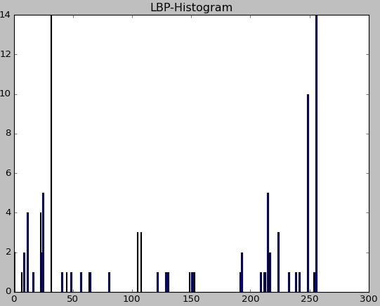
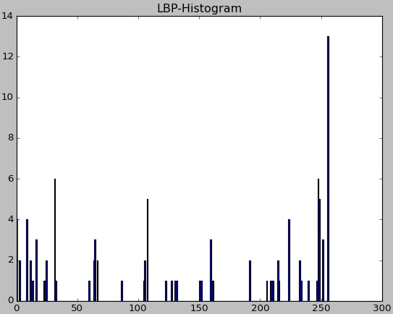
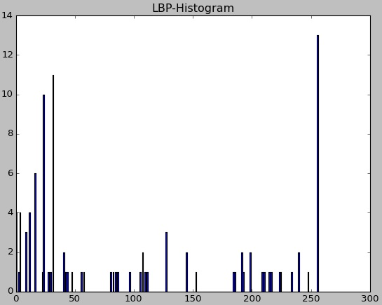
Calculate the LBP-histograms of each block and compare it with the K-modelled histograms
.
.
.
LBP histogram of highlighted
block
LBP image
K-modelled histograms
of highlighted block

Slide 9

Comparison B/w Histograms
Histograms are compared using a distance measure
We use histogram intersection as the distance measure in our method
Two normalized histograms $X_{1}$ and $X_{2}$ can have histogram intersection as :
H($X_{1}$, $X_{2}$) = $\sum_{i}{min⁡(x_{1,i} , x_{2,i})}$
where, i is the bin index of the histogram
We say two histograms to be similar if the H-value is greater or equal to the user defined threshold value $T_{D}$

Slide 10

So, if the histogram of a new coming block is similar to any of it’s model histogram:
(i) We update the bins of the matched model histogram as:
$X_{k,t}$[i] = $α_{b}X_{t}$[i] + (1-$α_{b}$) $X_{k,t−1}$[i] , $α_{b}$ $∈$[0,1]
where, $X_{k,t}$ = $k^{th}$ matched model histogram at time ‘t’
$α_{b}$ = user defined learning rate
(ii) Weights $ω_{k,t}$ as:
$ω_{k,t}$ = (1-$α_{ω}$)$ω_{k,t−1}$ + $α_{ω}M_{k,t}$ , $α_{ω}$ $∈$ [0,1]
where, $ω_{k,t}$ = weight of $k^{th}$ matched model histogram at time ‘t’
$M_{k,t}$= $\left\{\begin{aligned}1 for matched histogram \\ 0 otherwise\end{aligned}\right.$
$α_{ω}$ = user defined learning rate

Slide 11
If none of the model histograms is matched with the new histogram then,
(i) If number of model histograms is less than k, we append new histogram at the last position.
(ii) If not, we replace the lowest weight histogram with the new histogram
and assigns it a lowest initial weight.

Slide 12


SELECTION OF MOST PROBABLE BACKGROUND MODELS
Once we are completed with all the frames we have to decide which k-model histograms are most likely to form background by using the following eq.:
$ω_{1,t}$ + … + $ω_{B,t}$ > $T_{B}$ , $T_{B}$ $∈$ [0,1]
i.e. out of the k-model histograms we will select only first B-histograms
based on the user defined threshold value – ‘$T_{B}$’
If $\left\{\begin{aligned}T_{B}is large multi−modal background \\ T_{B}is small single−modal background\end{aligned}\right.$

Slide 13
Foreground detection
Once we have selected background models for each block of the image, we have to compare the new coming frame to these background models block-wise.
If a match is found, ‘Background’
If no match is found, ‘Foreground’

Slide 14
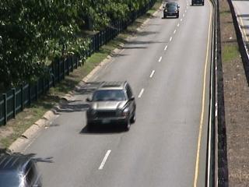
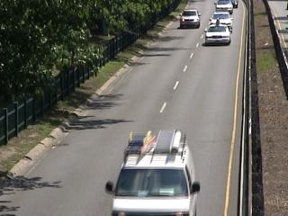
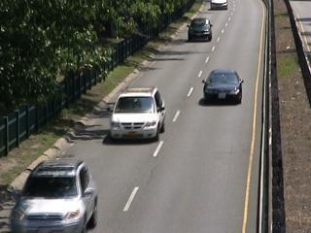
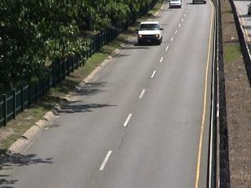
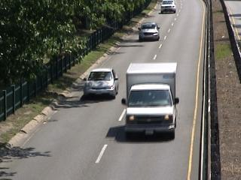
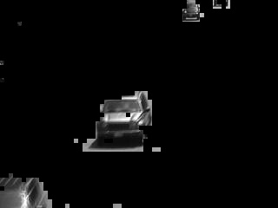
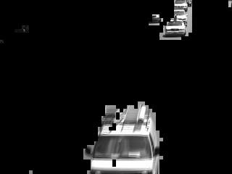
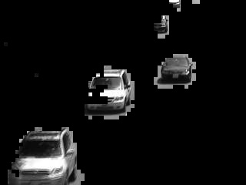
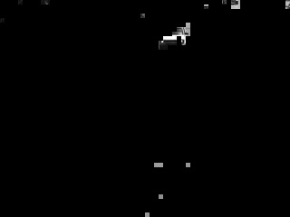
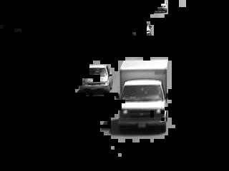
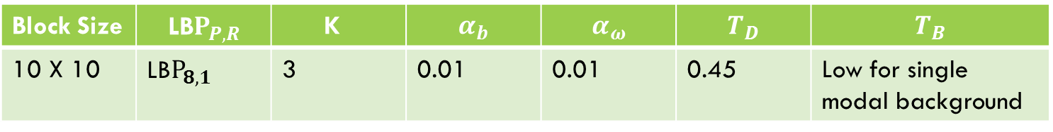
Experiment result
Block Size | LB$P_{P,R}$ | K | $$α_{b}$$ | $$α_{ω}$$ | $$T_{D}$$ | $$T_{B}$$
10 X 10 | LB$P_{8,1}$ | 3 | 0.01 | 0.01 | 0.45 | Low for single modal background
The parameter values used in the experiment
Frames from an outdoor test sequence where vehicles are moving on a highway

Slide 15
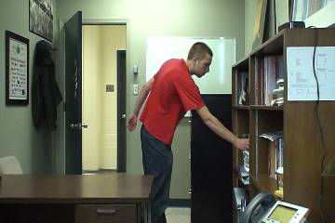
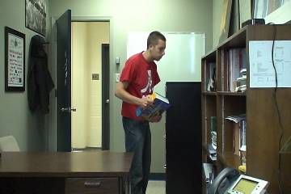
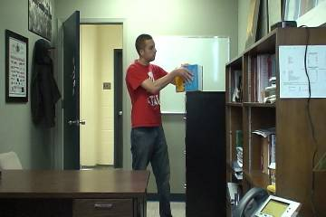
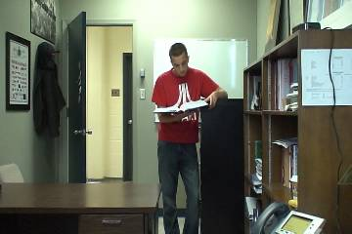
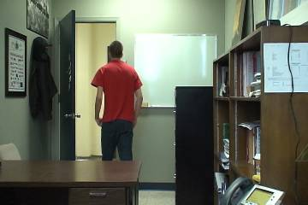
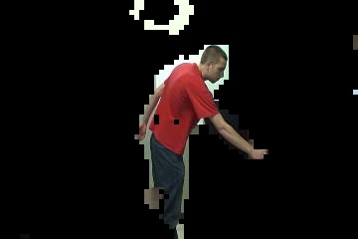
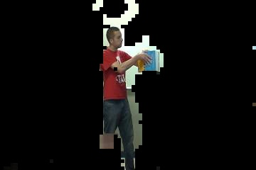
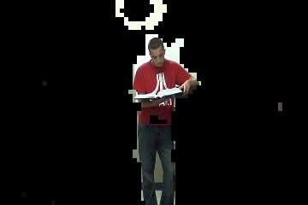
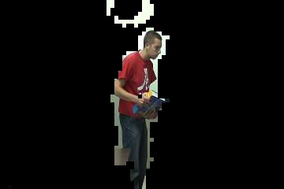
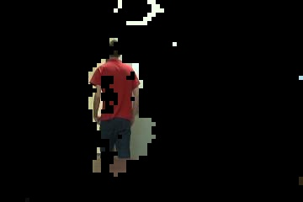
Frames from an indoor test sequence where a person is working in an office

Slide 16
The End!

